Slide 1
TRAVEL
By: Tori Trimble

Slide 2

What is Travel?
Travel is the act of moving from one place to another. There are many different transportation devices that allow you to travel, the most popular ones being...
By car
Train
Plane
Ship/boat
Foot

Slide 3
Most Popular Travel Destinations
Millions of people travel/go on vacation to a different country every year. This chart shows the 10 most popular countries that tourist travel to, and how many people travelled to them in 2013.

Slide 4



Top 3 Travel Destinations
FRANCE
UNITED STATES
SPAIN

Slide 5

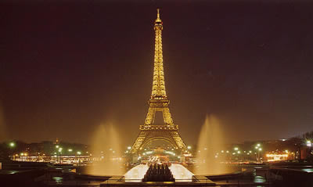
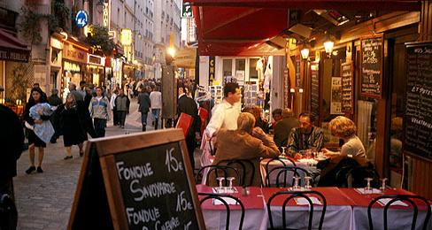
France
Captivating, classy, and romantic, France is the world’s top tourist destination. It has a variety of landscapes, and very rich culture. It is the center of fashion, cuisine, art and architecture.

Slide 6
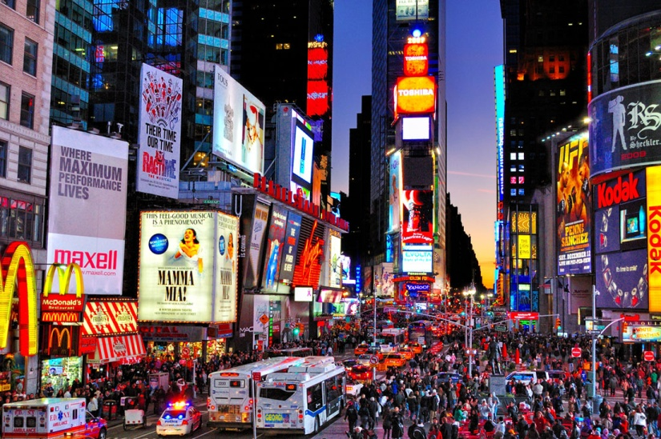

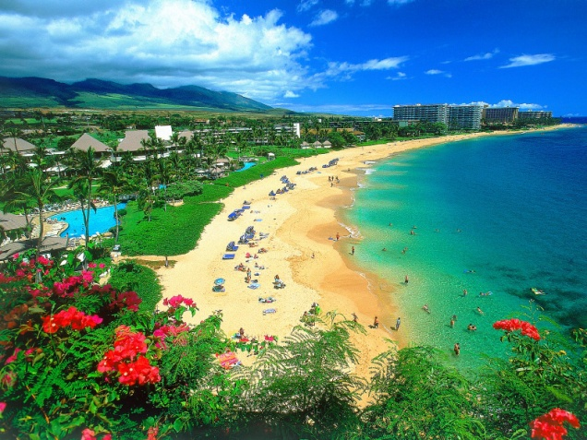
United States of America
The United States is a very popular travel destination because of locations like Florida, Arizona, New York City, and Hawaii. The U.S.A has many fascinating locations, and has a very diverse culture.

Slide 7
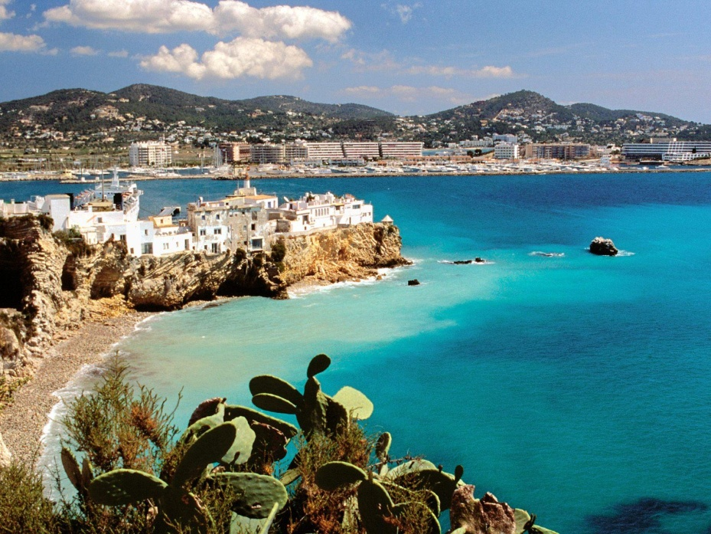

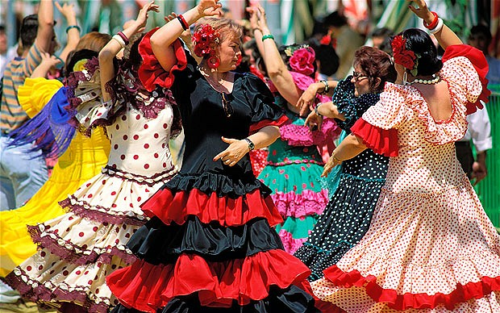
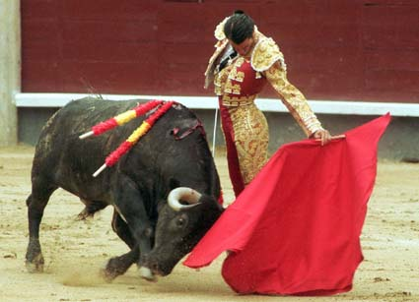
Spain
Spain’s breathtaking beaches, along with rich artistic heritage, the variety in cuisine, and it’s festive/party atmosphere attracts millions of visitors every year.

Slide 8
“The world is a book and those who do not travel read only one page.”
-Augustine of Hippo

Slide 9

Thanks for Watching!
Works Cited
http://www.donquijote.org/culture/spain/
http://usatravel.about.com/od/Top-Destinations/ss/Top-10-USA-Destinations.htm4
http://about-france.com/in-brief.htm

