Slide 1

What makes an effective presentation
By: Tori Trimble

Slide 2

Introduction…
There are many things you should take into consideration before creating, or presenting a presentation.
The important things to remember are the four P’s:
Plan
Prepare
Preform
Persuade

Slide 3

Plan
When planning your presentation you are going to want to…
Analyze your audience
Gather information
Establish your key message

Slide 4

Prepare
You have to prepare your content. The most important things to prepare are..
An introduction
The body of the presentation
A conclusion

Slide 5

Perform
There are 3 different things to consider when you are preforming your presentation.
Your body language
Your appearance
Your voice and tone
Considering and applying these things to your presentation, will help you to look more professional and keep the audience interested.

Slide 6
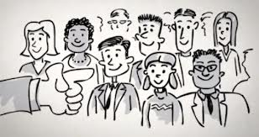
Persuade
When presenting, your goal is to get everybody to agree with you, get your point across, or educate others. You want to seem very knowledgeable on your topic.
You can do this by…
Leaving time for questions
Keeping the message clear
Repeating critical information
Making people want to buy-in
By Be engaging

Slide 7


Slide 8
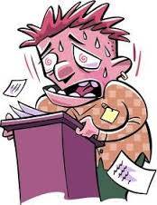
When speaking…
Breathe
Speak slowly and clearly
Vary your tone and pace
Pause regularly
Maintain eye contact

Slide 9

Minimize the number of slides.
Choose a simple font style.
Choose a font size that your audience can read from a distance.
Keep your text simple by using bullet points or short sentences.
Use graphics/visuals (should be one on every slide).
Label any charts or graphs
Make slide backgrounds subtle and keep them consistent.
Choose an appealing, yet simple, template or theme.
Use high contrast between background color and text color.
Check the spelling and grammar.

Slide 10

Other Important
Factors
Show up early and verify that your equipment works properly.
Turn your screen saver off.
Ask your audience to hold questions until the end.
Stay on time
Keep your presentation short and to the point
Stay on topic
Monitor your audience's behavior.

Slide 11

Conclusion
A good presenter has the ability to engage his or her audience from beginning to the end. If these tips are taken into account, it is guaranteed that you will have an effective presentation, and do just that. You will also appear more knowledgeable and professional.

